Slide 1
LGB&T Communities South Asian Domestic abuse

Slide 3
Additional risks for LGB people
Outing
Threatening to disclose somebody’s sexuality to friends/family/pupils/work
HIV status
Perpetrator HIV+ -using victim as nurse, emotional abuse claiming nobody will want perpetrator if victim left
Victim HIV+ -HIV status used in a similar way to outing, perpetrator withholding medication, perpetrator using emotion abuse by stating nobody will want a HIV+ partner so they shouldn’t leave
First LGB&T relationship
Perpetrator saying ‘this is what happens in a same sex relationship, can happen at any age

Slide 4
Additional risks for LGB people
Isolation
People may have poor relationships with friends or family members after coming out as become more dependent on perpetrator
Sexual violence
Forced to perform unwanted sexual acts, encouraged to have sex with other people, encouraged to attend sex parties
Using children
Emotional blackmail around outing to children

Slide 5
Additional Risks for trans communities
Outing
Threatening to disclose somebody’s gender identity to friends/family/pupils/work
Physical & mental abuse
Physically assault somebody’s surgically altered body parts
Refusing to use correct name/pronoun of victim
Financial dependence
Trans people far more likely to be financially dependent on a partner

Slide 6
Additional Risks for trans communities
Isolation
Withholding medication/clothing/make-up
Increased isolation from friends or family
Surgery
Forcing victim to have surgery to look the way the perpetrator wants them to look
Forcing victim to expose scars or surgically altered body part
Sexual Abuse
Forced to have unwanted sexual relations or perform unwanted sexual acts

Slide 7
South Asian communities
Family members- LGB&T people often experience familial abuse centered around their LGB&T identity.
‘Honour’ Based Violence
Forced marriages
Sexual Violence
Gender identity forced to dress or look in the way they want them to
Rituals to caste out the demon
find a ‘cure’
What other people say has a huge impact

Slide 8
South Asian messages
Religion
Culture
Community
Parents success
Marriage proposals self/siblings

Slide 9
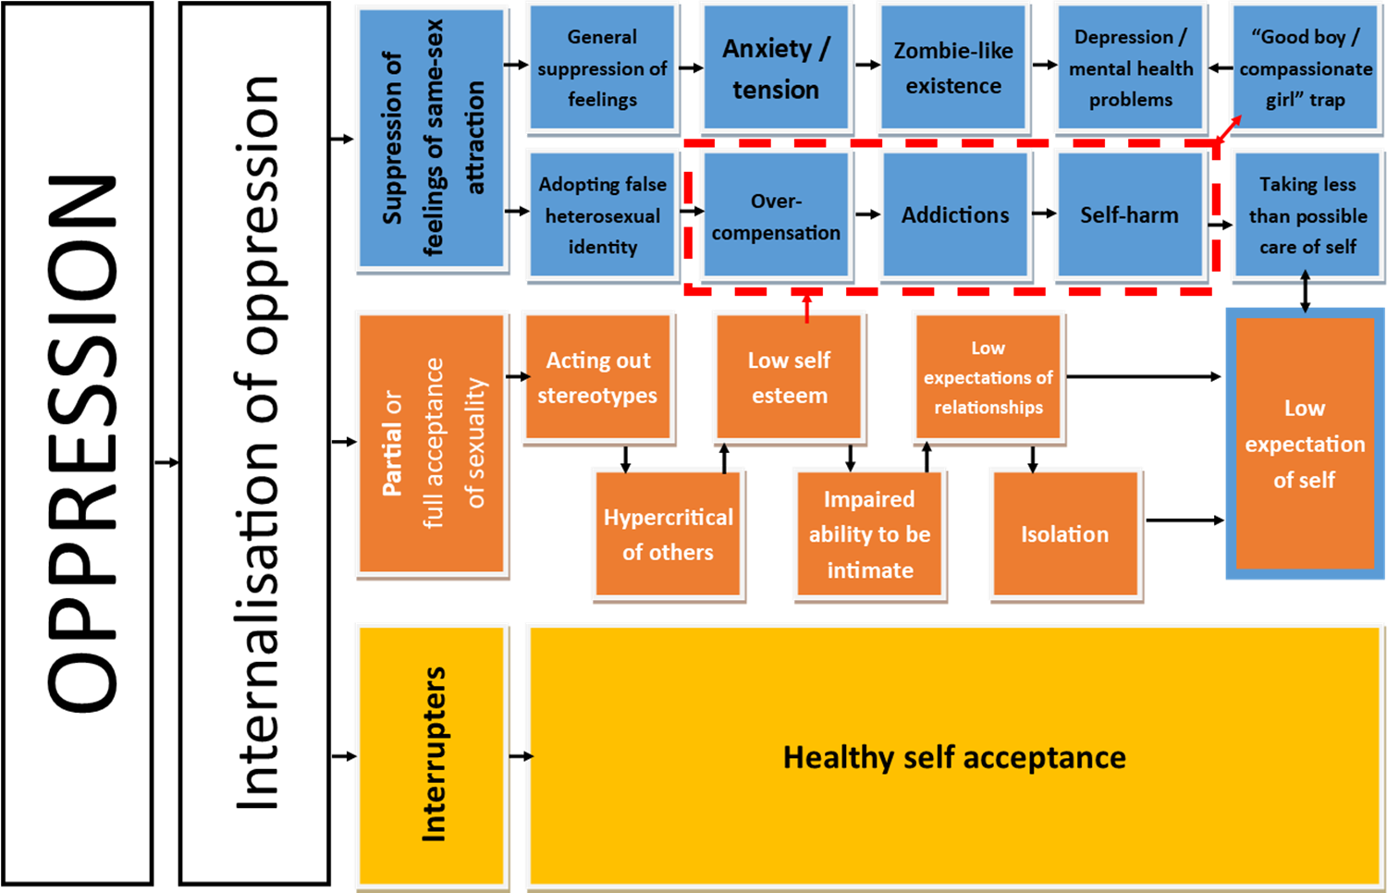

Slide 10
Interrupters
Leaving home, friends and family
Accessing support from Trade
Not waiting to get approval from family, they will never accept me
Meeting other gay Asian men
Accessing DV support specifically for Asian people
LGB&T Counselling
Police
My faith leader
Access specialist services

Slide 11
How to be more LGB&TQ inclusive?
Language – e.g. partner, don’t assume based on appearances, asking for preferred pronouns
Zero tolerance, gender neutral toilets
Safe space – e.g. boundaries, speak up
Visibility – e.g. promotion materials, role models,
Work with local LGB&T services
Ensure your staff/volunteers are trained in LGB&T DA
Work with wider South Asian communities
Culturally appropriate venues
LGB&T – events – into those communities
Faith leaders

